Slide 1
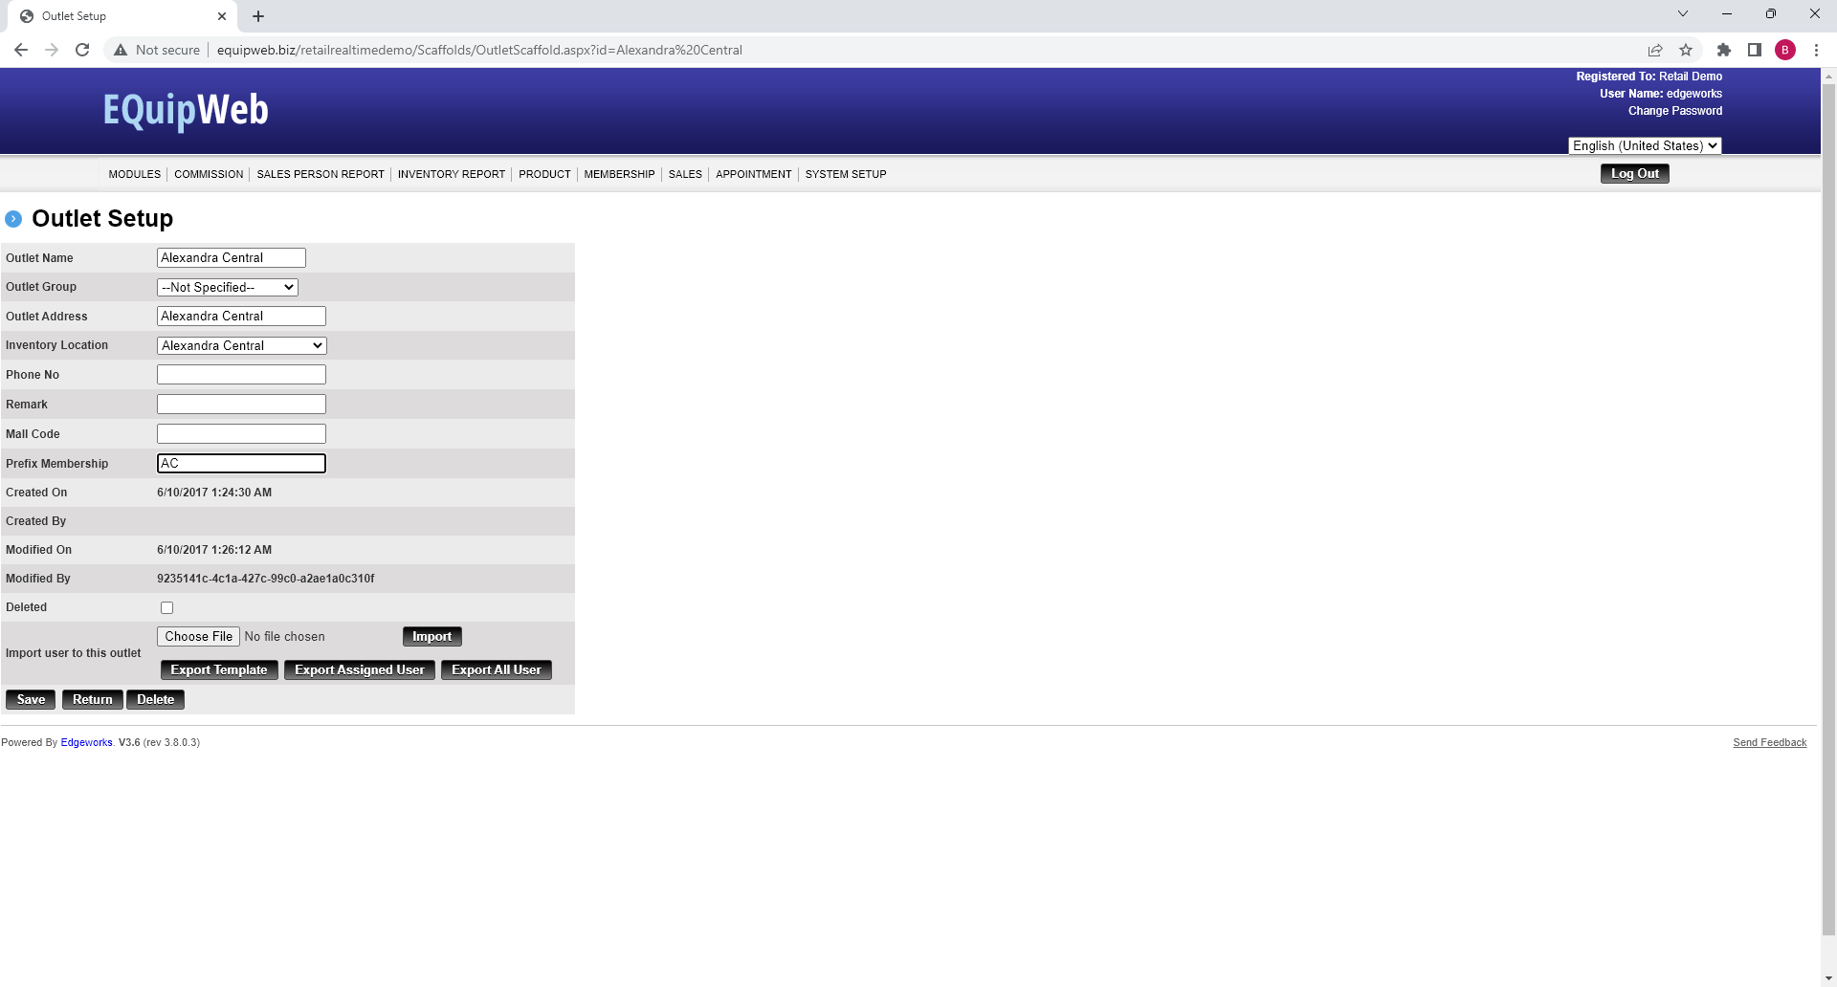
Guestbook Setup
Under outlet setup
Click edit for the outlet
Enter prefix membership
Click save

Slide 2
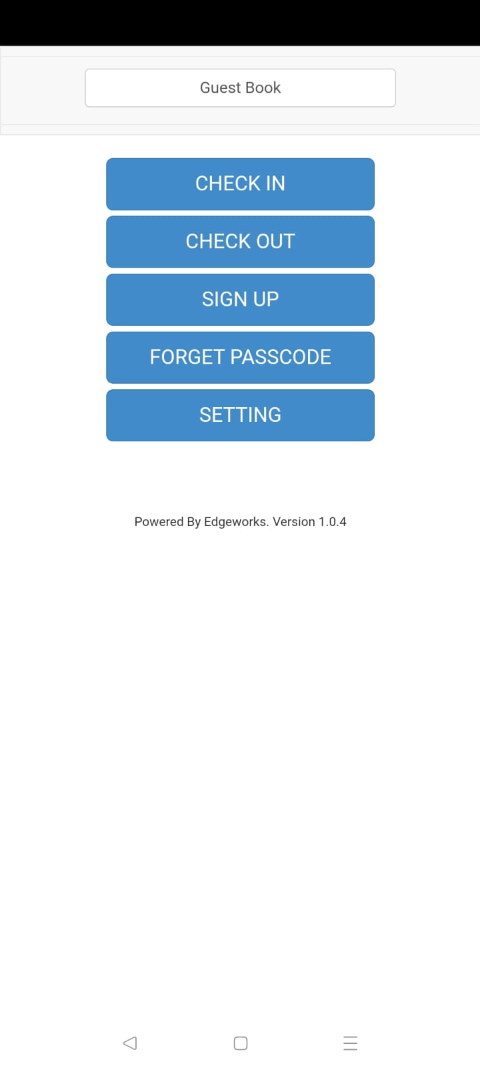
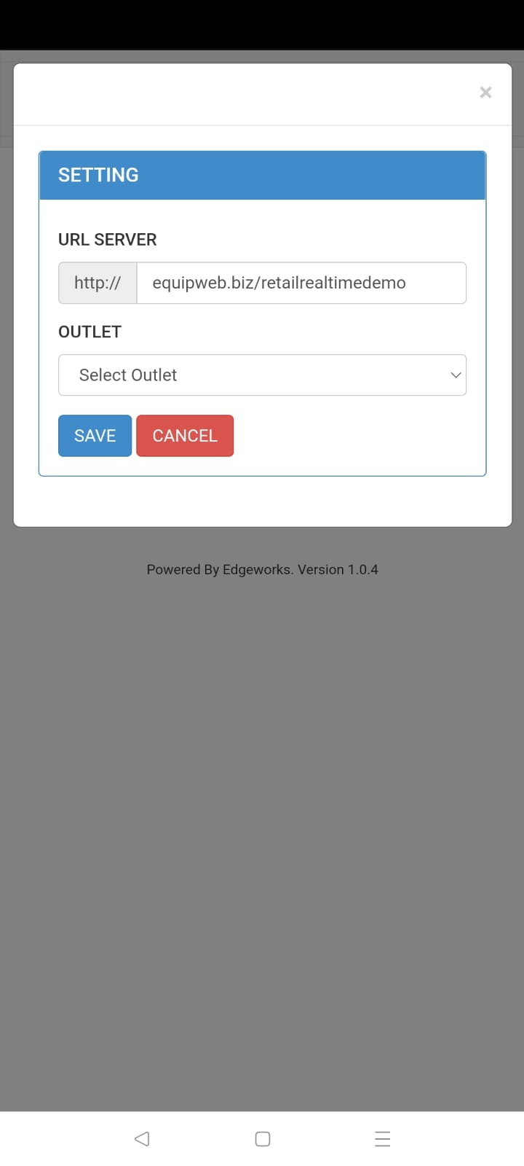
Guestbook Setup
Click to start the app
Click setting
Enter URL
Click blank area
Select outlet
Click save
Test guest book functionality

Slide 3
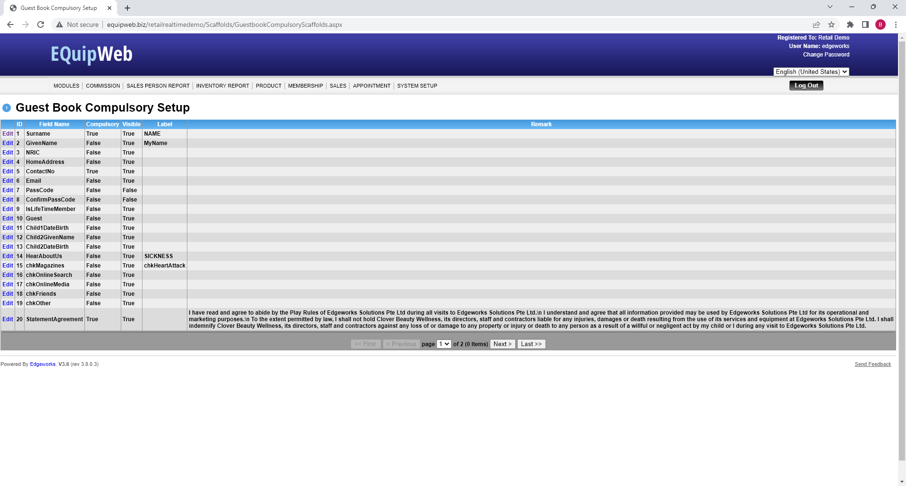
Guestbook Setup
Access the backend equipweb > system setup
Access the guest book compulsory setup
Setup all the necessary field based customer need
Enter the term & conditions based customer need

